Slide 1


A report submitted for the partial fulfillment in requirement for the Degree of Bachelor of Science
In Computer Science
WEST BENGAL STATE UNIVERSITY
Submitted by
Labani Das | Sahim Khan | Rahul Kumar Shaw
Roll No: 623213419578 | Roll No: 623110706582 | Roll No: 623110706593
Reg No : 1032021100062 | Reg No : 1032012600053 | Reg No : 1032011400054
Under the supervision of
Dr. Anirban Chakraborty
Department of Computer Science Barrackpore Rastraguru Surendranath College affiliated to West Bengal State University, Barasat

Slide 2

Face Recognition Attendance System
ATTENDANCE SYSTEM​

Slide 3
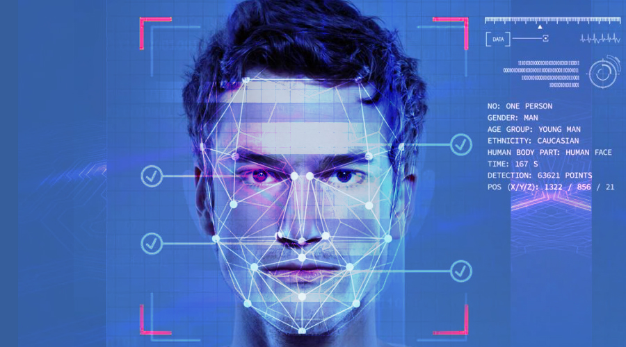
Table of contents
Introduction
Purpose
Features added
Software and Hardware Requirements
Preliminaries
HOG Algorithm
System Overview and Flowchart
Screenshots of working System
Benefits And Limitations
Future Scope
Conclusion

Slide 4
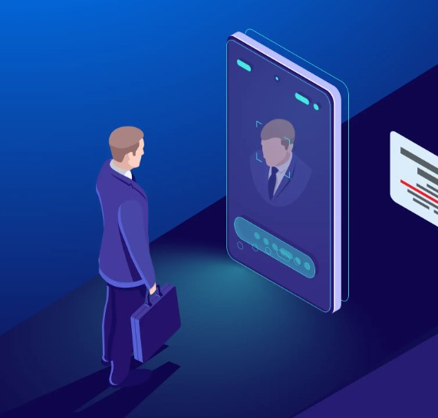
Introduction
As we are making a system which can recognize face and match with its own database. It will make the attendance system more authentic. Our primary goal is to help the lecturers, improve and organize the process of track and manage student attendance and absenteeism.

Slide 5
Purpose
1. Attendance
2. Verification
3. Surveillance
Students or employees' faces are recognized as they enter the premises, reducing manual attendance tasks and improving accuracy.
verify individuals' identities and control access to secure areas or devices
identify and track suspects or persons of interest in CCTV footage or public areas
4. Access Control
5. Law Enforcement
control access to secure areas or devices, replace traditional methods like passwords or ID cards, providing a more convenient and secure authentication process
It aids in solving crimes and enhancing public safety.

Slide 6




Features added
Real time
Verify users
Register users
Show user identity
Supported with real time database that immediately updates the changes
Verify and identify users using their unique facial features to mark attendance
Easy to register users (candidates) so that their attendance can be kept track of
Show virtual user id’s immediately to user once their face is identified

Slide 7

Software requirements
Python version 3.7.6
Pycharm IDE
Hardware requirements
Computer of operating system Windows, Linux or Mac
Webcam

Slide 8

PRELIMINARIES
Face Recognition Algorithms .
FACE LANDMARK ESTIMATION ALGORITHM
HAAR CSCADE
Facial landmark detection algorithms help to automatically identify the locations of the facial key landmark points on a facial image or from a video. The key landmark points normally includes the facial regions like nose tip, eye corner, eye brows and chin tip. Some applications of facial landmark detection are face swap, head pose detection, detecting facial gestures, gaze direction etc.
A Haar classifier, or a Haar cascade classifier, is a machine learning object detection program that identifies objects in an image and video.
FACENET
FaceNet is a deep learning algorithm developed by Google that learns to map faces to a 128 dimensional vector space, known as face that similar faces are clustered closely together, enabling accurate face recognition and verification. FaceNet's embeddings facilitate efficient face matching, allowing it to recognize faces with high accuracy, even across large databases, making it a pivotal advancement in face recognition technology.
HISTOGRAM OF ORIENTED GRADIENTS ALGORITHM
HOG is a simple and powerful feature descriptor. widely used for object detection like cars, pets, and fruits. HOG is robust for object detection because object shape is characterized using the local intensity gradient distribution and edge direction.

Slide 9
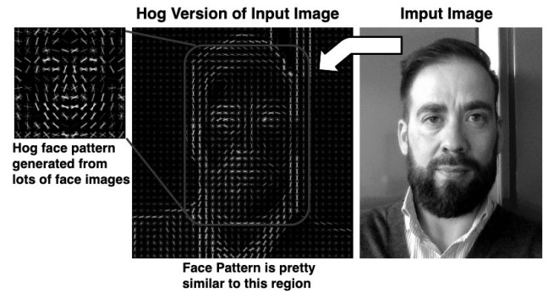
HOG is a simple and powerful feature descriptor. Widely used for object detection like cars, pets, and fruits. HOG is robust for object detection because object shape is characterized using the local intensity gradient distribution and edge direction. 1. Preprocessing (Gamma/Color Normalization and Resizing)image. 2. Computing the Gradients. 3. Dividing the image into cells. 4. Get the HOG Feature Vector.
HISTOGRAM OF ORIENTED GRADIENTS ALGORITHM
An image showing the working of HOG algorithm

Slide 10
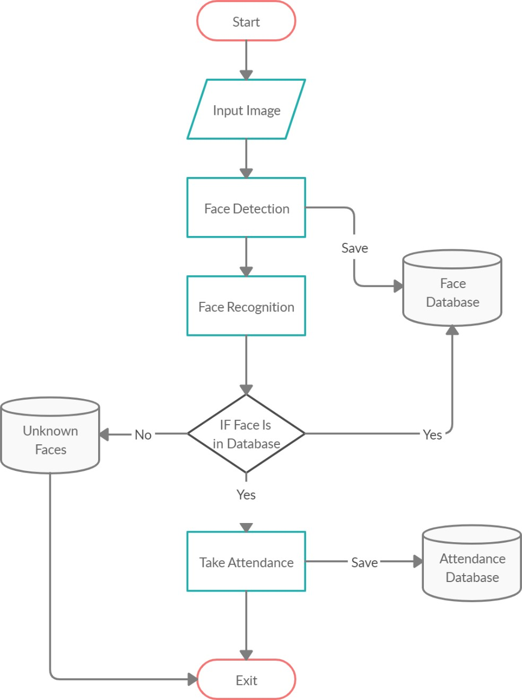
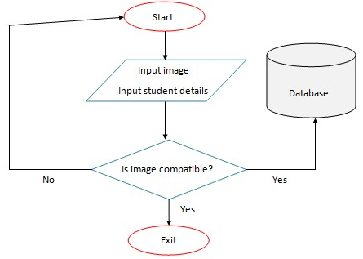
System overview and flowchart
For taking attendance
For registering students/ employees

Slide 11
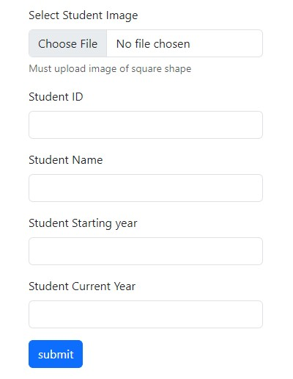
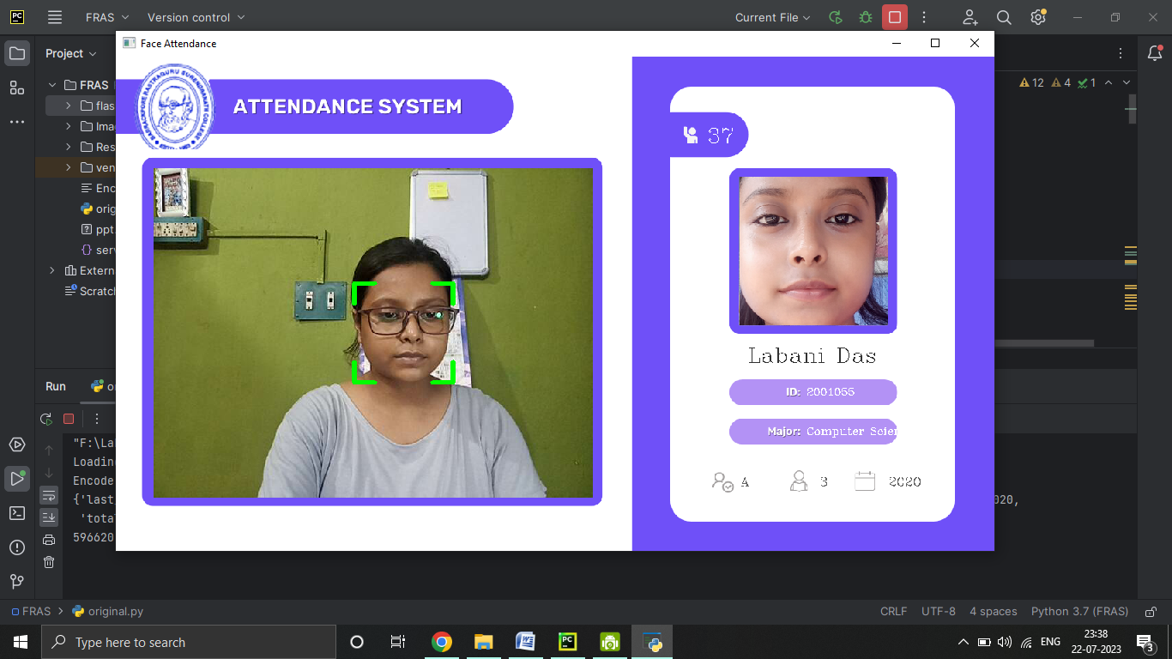
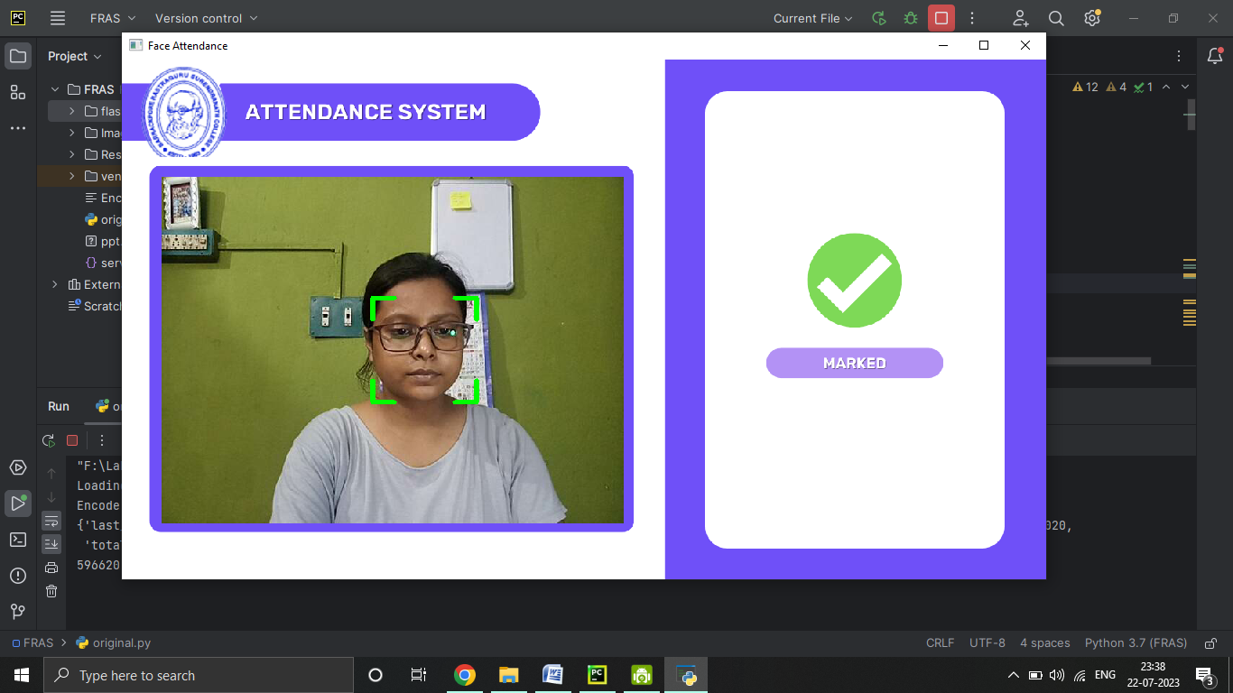
Screenshots of working systeem
Form for registering students
Taking live attendance and showing id card
Mark present after taking attendance

Slide 12
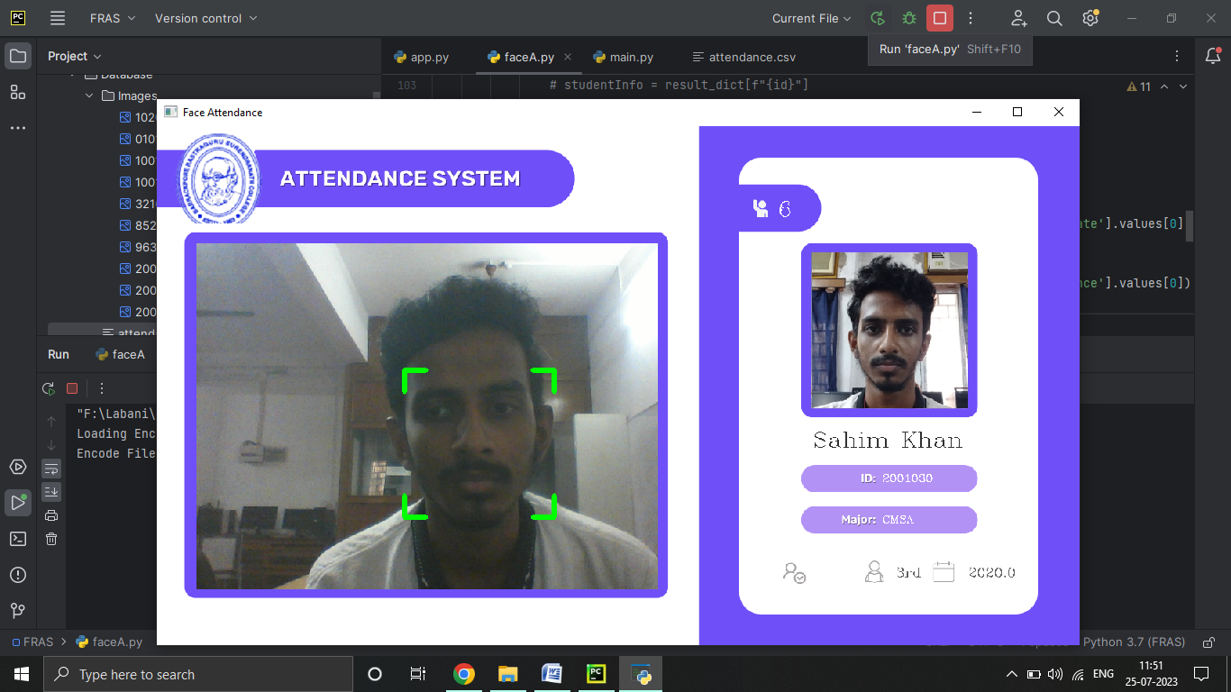
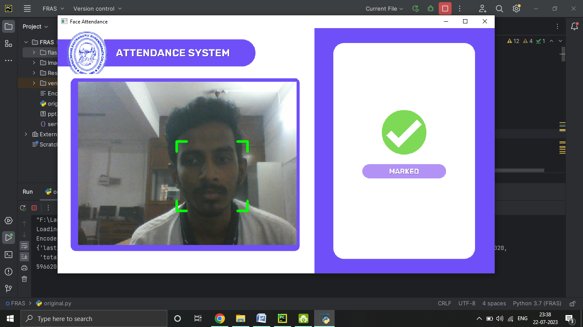
Taking live attendance and showing id card
Mark present after taking attendance

Slide 13
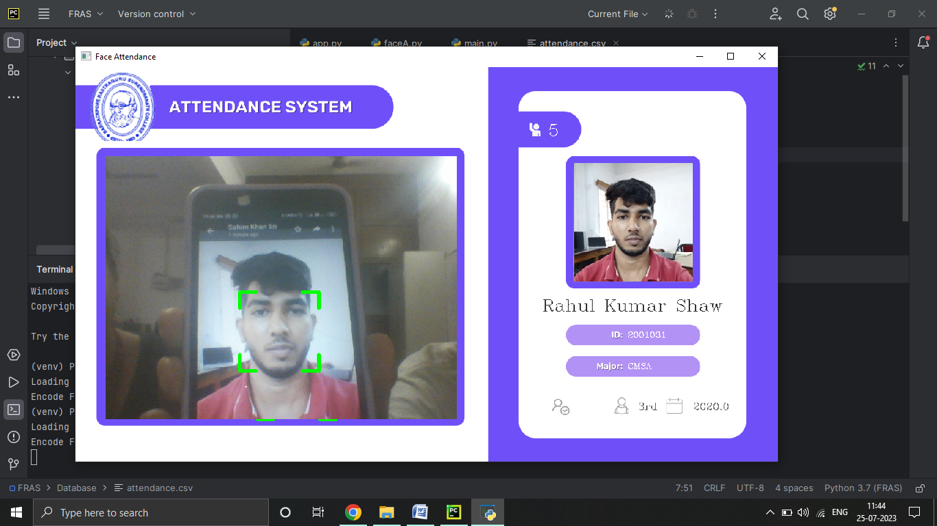
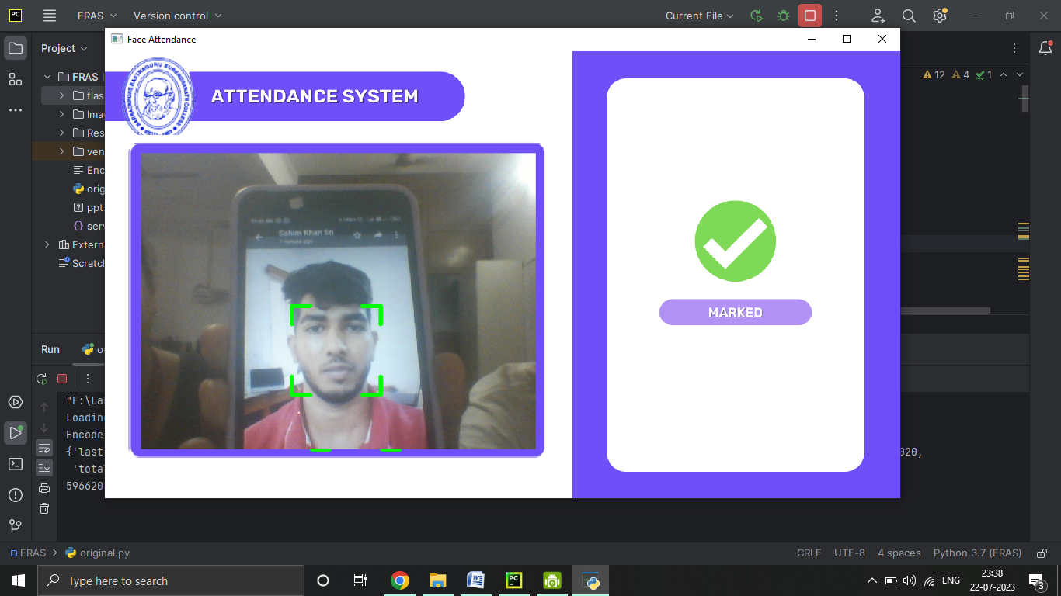
Taking live attendance and showing id card
Mark present after taking attendance

Slide 14
BENEFITS AND LIMITATIONS
BENEFITS
Automate attendance system
Recognise and register attendance in seconds
Easy to use
LIMITATIONS
The accuracy of the system is not 100%. It can only detect face from a limited distance.
Sometimes slow as it data is constantly processing and being accessed from database in every iteration
Cannot be used offline

Slide 15
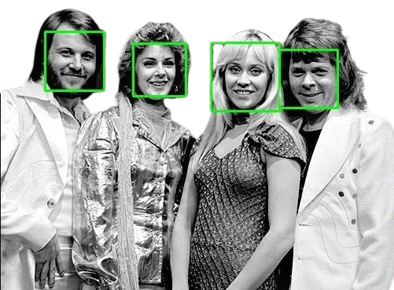
Future scope
Performance Optimization: Optimize the face recognition algorithms and techniques to make the system faster and more efficient.
Multiple Face Detection: Extend the system to handle the detection and recognition of multiple faces in an image or video stream.
Security and Privacy: Enhance the security of our system by implementing measures to prevent unauthorized access or tampering with the data
User Interface and Experience: Improve the user interface and experience of the system to make it more user-friendly and intuitive.

Slide 16

COnclusion
The face recognition system developed in Python efficiently detects and recognizes faces in images and videos. It uses state-of-the-art algorithms to identify individuals and can handle multiple faces simultaneously. The system offers real-time video stream processing, optimized performance, and potential applications in security, access control, and user analytics.

Slide 17
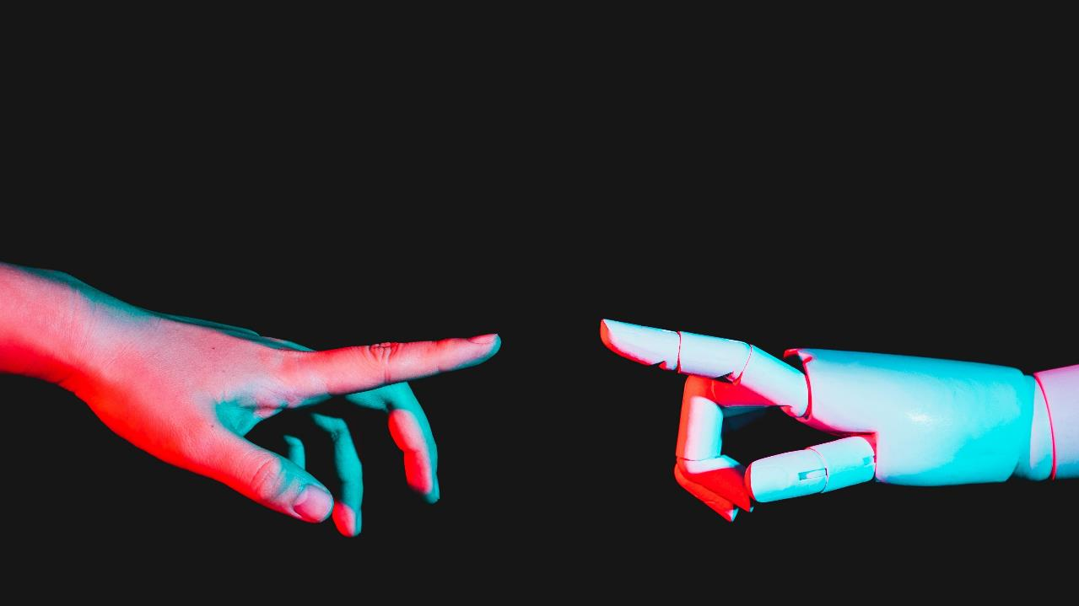
Thank you

